Slide 1


SEICHE 2022 Basic Arduino Programming
Instructor: Paul Frommeyer
www.paulfrommeyer.com
Corporate Sponsor: DXC Technology

Slide 2
Lesson Plan Overview
Lesson 1 – Intro and Setup [may require 2 classes]
Introduction to class format
Overview of lesson plan
Presentation format (monitor, camera, screen, whiteboard)
Review of microcontrollers and types of boards
SEICHE LED display architecture
ESP8266 pinout
High level architecture
Lesson 2 – Laptop operation review – Windows and Linux
Inventory of USB drives
Installation of Arduino IDE software
Installation of CH340/ESP8266 serial port drivers (Windows only)
Control panel/settings location
Home directories and folder hierarchy
Arduino file locations
Search functions
(Windows) Device Manager
(Linux) Konsole
Copying flash drive contents [critical]
Open questions and issues
Lesson 3 – IDE essentials
Starting the Arduino IDE
Basic Arduino sketch (program) structure
Loading example sketches
Loading and configuring new boards
Connecting boards
Identifying the microcontroller serial port
Linux
Windows
Libraries
Uploading a sketch
The serial port monitor
Printing to the serial port monitor
A note on brace formatting
Lesson 4/5 – The Binary Number System (may take 2-3 lessons)
Numerals vs numbers
Review: the base 10 system and digit place values
New: the base 2 system and digit place values
Counting to 1000
Bits and bytes and nybbles
Binary addition and subtraction
Formatting printed output
Shifting and exponents
Lesson 6/7 – Integers and Arithmetic Operators (may take 2 lessons)
The integer data type
Variables and the assignment operator
Autoincrement and autodecrement
Arithmetic Operators
Assigning arithmetic results to a variable
Bytes as data types
Lesson 8 – Communicating with Sensors
Reading a potentiometer
Reading a button
Initializing I2C sensors
Reading I2C sensors
Lesson 9 – Characters and Arrays
The hexadecimal number system
Representing characters as numbers
The ASCII character code
The char data type
Strings and character arrays
Lesson 10 – Comparison Operators
==, =>, <=
strcmp
Binary comparisons
Uploading a sketch to the microcontroller
Lesson 11 – Control Structures
if-then-else
while
for-next
Lesson 12 – Programming the LED matrix
Initializing the SPI interface
Controlling display brightness
Lighting and clearing a single pixel
Displaying text on the LED matrix
Default fonts
Nested for-next loops

Slide 3
Lesson 2 – Desktops and IDE
Part A
Inventory of USB Drives
Control panel/settings locations
File manager/Explorer
Copying USB Drive Contents
Part B
Starting the Arduino IDE
Adding a new type of board
Finding and using example sketches
Port selection and usage review
Uploading a sketch to the ESP8266
Part C [Time Permitting]
Introduction to computer data representation

Slide 4
USB Flash Drive Inventory
DOCUMENTATION – Arduino Reference
Programming with Arduino.pdf
Arduino Cookbook-2ndEdition.pdf
Arduino-For-Beginners-REV2.pdf
IntroArduinoBook-AlanSmith.pdf
IntroductionToArduino-Book-AlanGSmith.pdf
Make_Getting_Started_with_Arduino_3E.pdf
DOCUMENTATION – Electronics Reference
the-original-guide-to-boards-2021.pdf
Basic Electronics-Semiconductors.pdf
Grobs Basic Electronics 2010.pdf
Instructables-Basic-Electronics.pdf
Intro to Electronics-Noisemantra.pdf
Make Electronics 2nd Edition by Charles Platt.pdf
SPIE-TT107-PracticalElectronicsforOpticalDesignandEngineering-Chapter1.pdf
DOCUMENTATION – ESP8266
ESP8266 pinout diagram
DOCUMENTATION – Boards Guides
Original Boards Guides from 2019-2022
Lessons
SEICHE-BasicArduinoProgramming-Lesson1
SEICHE-BasicArduinoProgramming-Lesson1-V1.pdf [PDF document]
SEICHE-BasicArduinoProgramming-Lesson1-V1.ppt [PowerPoint document]
Critical Documents
Make Getting Started With Arduino – Use for homework assignments
Arduino Cookbook 2nd Edition – Use for homework assignments and critical reference source
RETURN FLASH DRIVES AT END OF EACH LESSON
I’ll load new content each week, that week’s lesson and any sketches used in class

Slide 5
Laptop GUI Operation
Desktop and task bar
Start menu and control/settings panels
Launching applications
Context sensitive menus (right click)
Filesystem browsers
File and folder hierarchies
Searching for applications
Accessing and safely removing flash drives
Outside class scope: Application usage other than Arduino IDE, operating system customization

Slide 6
Laptop GUI Operation
Windows – Displaying Device Ports
Device Manager
Starting Device Manager in Windows 7 Start Menu -> Enter “device” in Search Box -> Select “Device Manager”
Starting Device Manager in Windows 10/11 Windows Key+R -> Enter “devmgmt.msc” in program box

Slide 7
Command Line Interfaces
Windows - CMD
Starting the DOS command line in Windows 7 Start Menu - > Search Box
Starting the DOS command line in Windows 10/11 Windows Key+R -> Enter ‘cmd’ in program execute box
Linux - Konsole
Starting Konsole from the start/application menu
Your instructor or class materials will provide what text to enter into the CLI interface for your particular OS

Slide 8
Command Line Interfaces
Linux – Displaying Serial Ports
Start a Konsole instance
Enter the following command “ls /dev/tty*”
Follow all CLI commands with a carriage return/Enter key
This is how you determine what port your board is connected as. 99% of the time, it will be /dev/ttyUSB0, and the Arduino IDE will automagically find it.

Slide 9
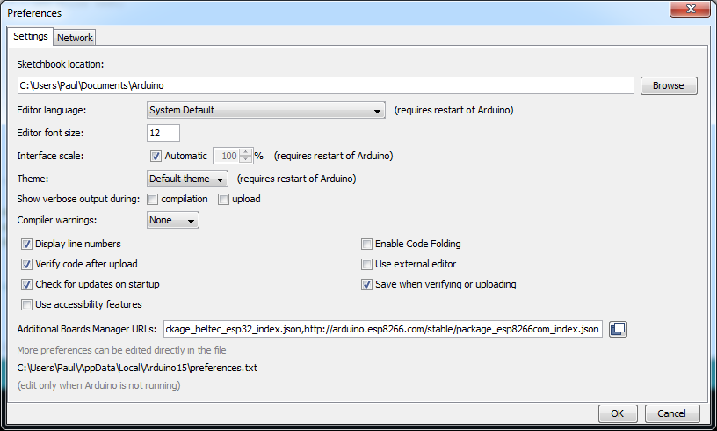
Adding the ESP8266 to the IDE
Open Preferences (File or Edit menu), and add the following URL to the Additional Boards Manager URLs field:
http://arduino.esp8266.com/stable/package_esp8266com_index.json

Slide 10
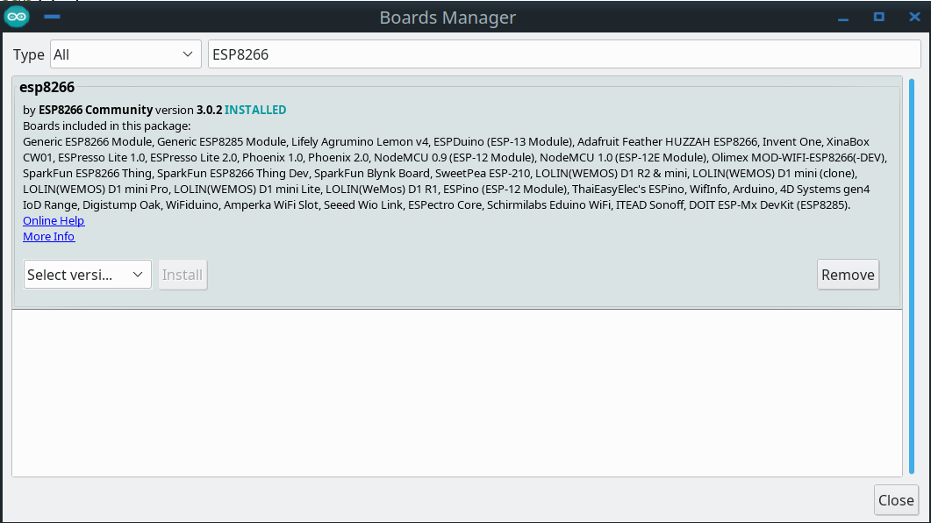
Adding the ESP8266 to the IDE
This will say
“Install” if not already installed
Open the Boards Manager (Tools menu), enter “ESP8266” in the search box at the top
Click on INSTALL (if it says “REMOVE”, the board is good to go)

Slide 11
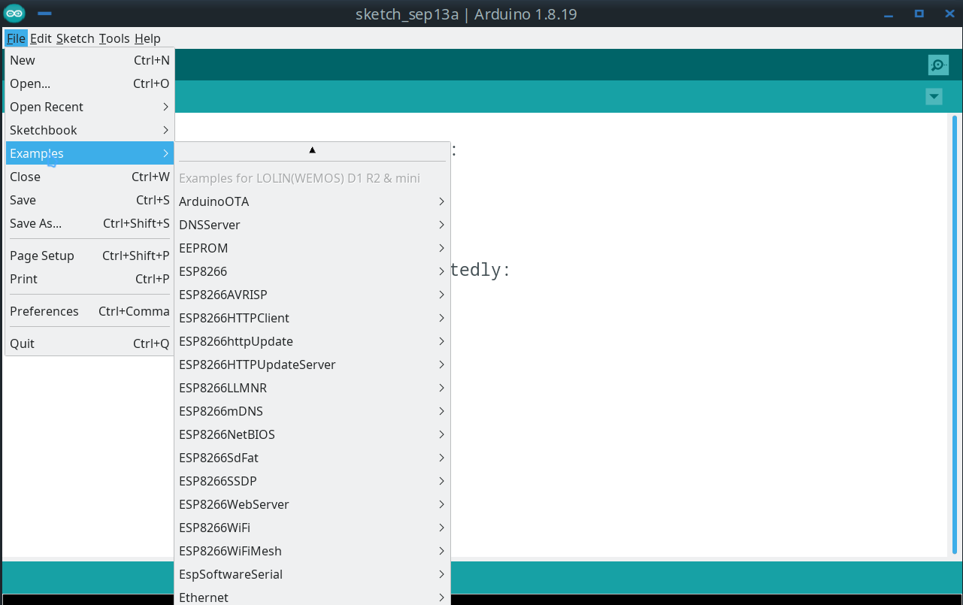
IDE: Using Examples – ESP8266
Open the Examples menu
Select the example you want
For today, select “BLINK” from “Built In Examples”

Slide 12
Preparing a Sketch
As mentioned, find the BLINK example sketch under Built In Examples”
Click on the “VALIDATE” check mark icon
DO NOT click on the “right arrow” (UPLOAD) icon at this time
This will compile the sketch and check for errors prior to upload
This is an optional step, since selecting upload will always compile the code first.
Whenever using a new board (or library) for the first time, it’s a good idea to validate just to assure the software is happy before attempting and upload
VALIDATE is extremely useful when troubleshooting code that won’t compile. Once it compiles without errors, it’s ready for upload.
X
This check mark icon is for VALIDATE

Slide 13
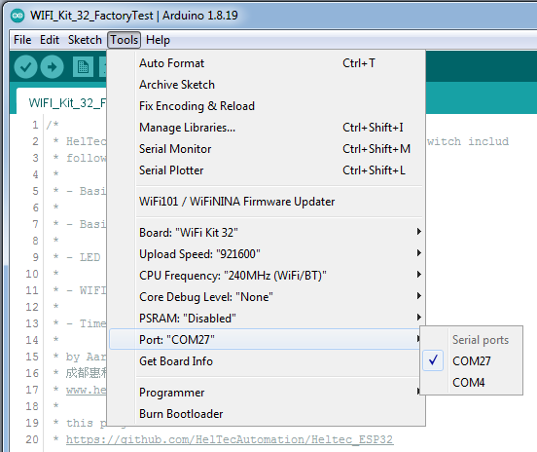
Finding and Setting the USB Port
WINDOWS
Use Device Manager to identify the USB port
The port will change with each connect/disconnect of the board
KUBUNTU
Port should always be /dev/ttyUSB0
The port will not change with connect/disconnect
You can use Konsole to verify the port presence ls /dev/tty*

Slide 14
Adjusting Port Speed
Always start by using 921600, this works with nearly all USB chipsets (there are exceptions for the ESP32, which uses the Sil2102 driver– but that’s not us!)
If you get an upload failure
Recheck port setting
Retry the upload with the next lowest speed
Lather, rinse, repeat until success
Suggested initial try order: 921600, 512000, 115200

Slide 15
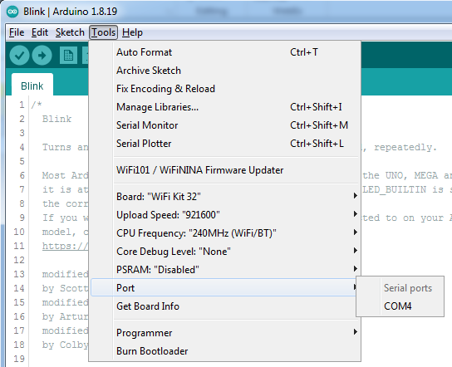
Uploading a Sketch
Ensure you have selected the correct port for your currently plugged in board
NOW click on the “UPLOAD” arrow icon
A light or lights should flash on your board
Once upload is finished, the sketch will immediately run
You should see the onboard LED on your board start blinking
Note: On the ESP8266, the LED is next to the silver CPU module

Slide 16
Introduction to Computer Data Representation
Chalk Talk – No formal class notes, sorry!
Lots of details on this next week, when we start learning about numbers and variables in C++.

Slide 17
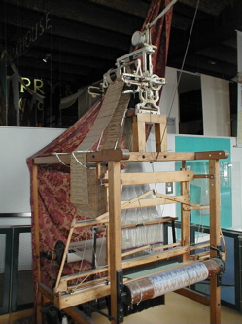
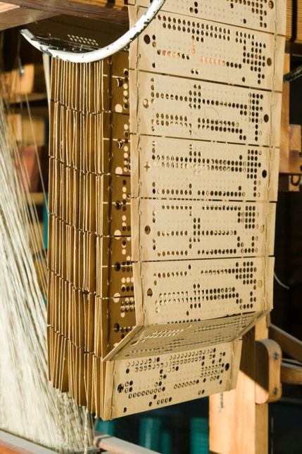
Jacquard Loom
Invented by Joseph Marie Jacquard in 1804
Technically, a Jacquard Machine which was attached to the heddles of an existing pattern loom
Provided automatic control of the heddles managing the warp threads
Used large punched cards to define the woven pattern
A hole in the card would cause that thread of the warp to be raised, thus excluded from the weft during a shuttle pass
Allowed extremely complex patterns to be woven
Once machine driven, gave rise to modern weaving industry
Mechanism still in use today, but electromechanical relay driven and controlled by digital computer

Slide 18
Von Neumann Architecture
Earliest computers had fixed (hardwired) programs
Control storage (program) was originally separate from data storage (information to be operated upon)
John Von Neumann invented the idea of using a single storage medium for both instructions and data
This was a revolutionary design, reducing costs and increasing flexibility, and is used by all computers since
Instructions
Data
Main Memory
Central
Processor
Processor
Input/Output
(I/O)
Results
Historic Architecture
Von Neumann Architecture

Slide 19
Formal End of Lesson 2
HOMEWORK!
Getting Started With Arduino – Chapter 3
Arduino Cookbook – Chapter 1
In next week’s exciting episode
Statements, values, and variables in C++
The serial port monitor
Computer data representation, Part 1

Slide 20
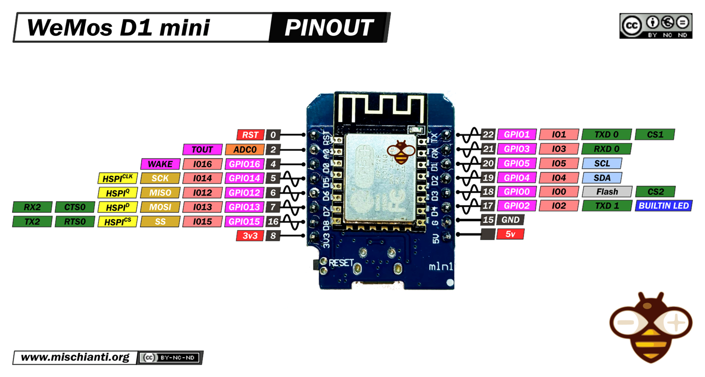
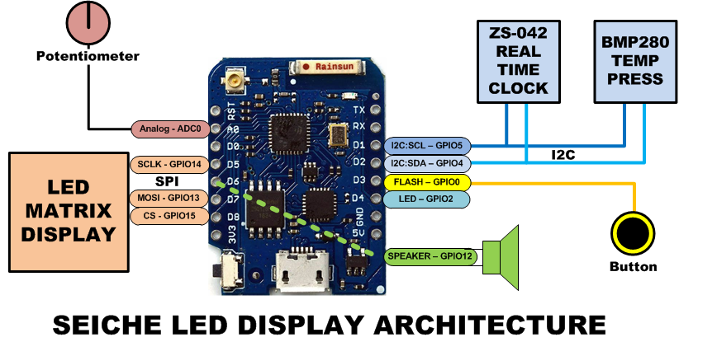
LESSON REFERENCE

